Slide 1
PROG8560-Project Development
Stones and Crystals Shop

Slide 2
GROUP 12
Stones and Crystals Shop
Ramandeep Kaur
Home Page Design.
Azure Management.
Video presentation
Yadwinder Singh
Login and Signup Design.
Git-Hub Reviews
PowerPoint Presentation
Carlos Alfonzo
Product List Design
Product View and Shopping Cart Design.
Final Project Upload

Slide 3
In this demo:
Project Details
Signup for Account
Product List
Product View
Shopping
Sign-out

Slide 4
Project Details:
Client details:
There are a lot people looking for places where to buy Stones and Crystals (Among other similar geological stuff) around the country. Our current client has a warehouse with two stores in Waterloo where he offers these kind of products.
He is looking or a way to expand his business, so he is asking us for a Web Site solution where he can show all products in the store, and where any client have the opportunity to buy online.

Slide 5
What can we offer to our client?
Project Description:
The Web site will consider a home page where client can show all information about the business. There will be also a section for login/logout for registered customers. A signup section is also included for new client enrollment. The list of products where to buy from, and the shopping cart is also showed to our client in order to explain the flow of the web site.

Slide 6
Special note for the project:
This is considered as a basic beginning for the solutions. Other requirements will be discussed with client as the project goes on.

Slide 7
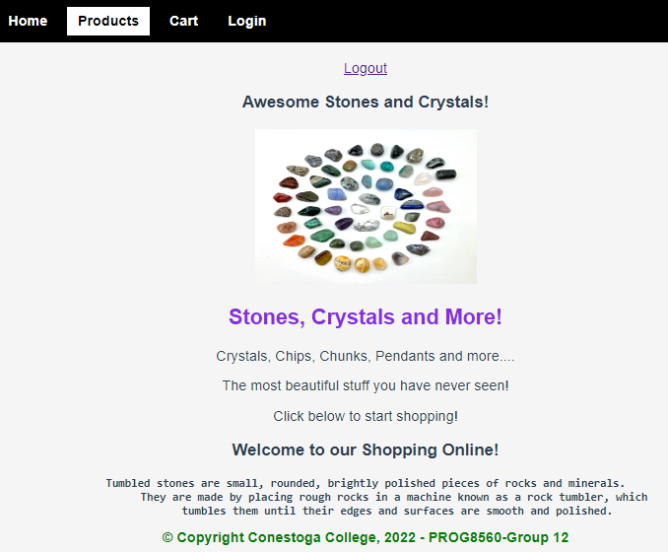
Home Page

Slide 8
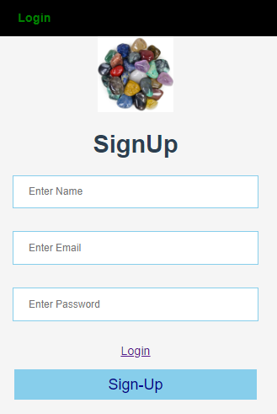
Login/Signup

Slide 9
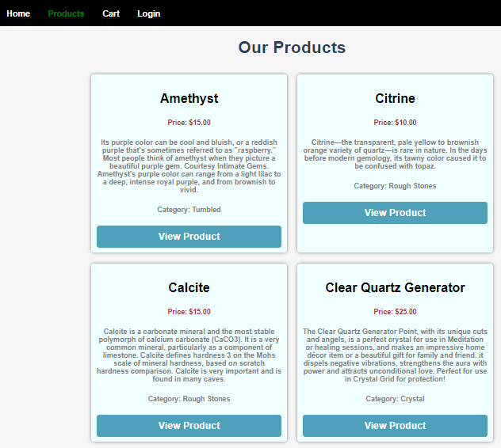
Product List

Slide 10
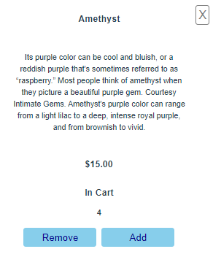
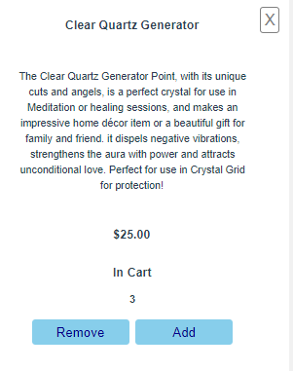
Products View

Slide 11
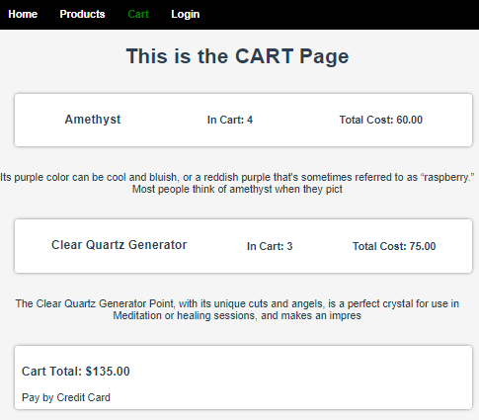
Shopping Cart

Slide 12
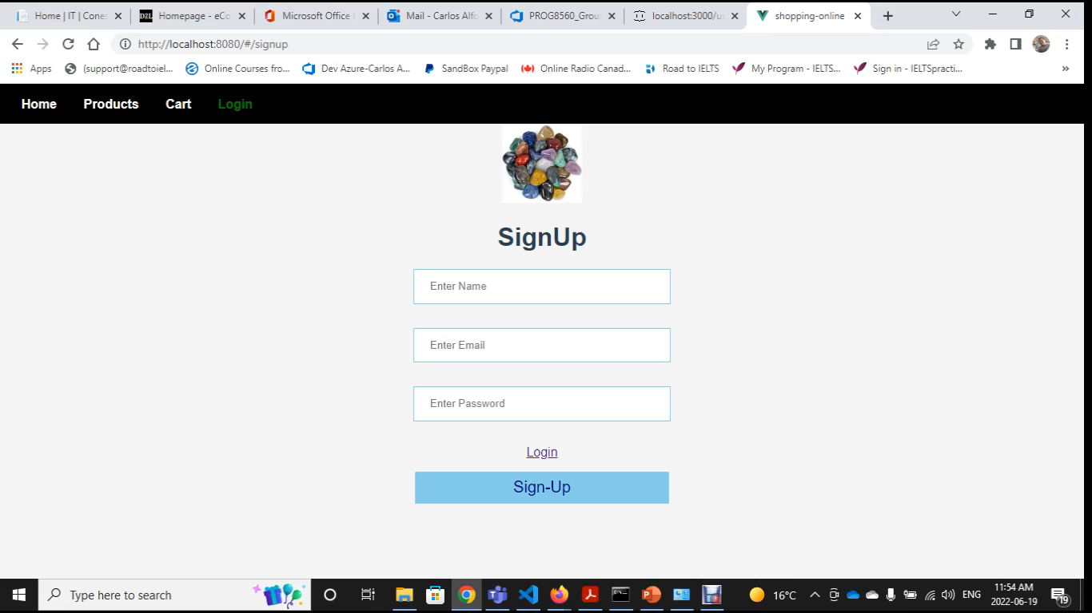
Demo

Slide 13
Thank you

